Slide 1


SMART INDIA HACKATHON 2026
SkyGuard ~ Excalibur
  Problem Statement ID – 26073
  Problem Statement- AI/ML Based Intelligent Anomaly Detection for Automatic Weather Stations (AWS)
  Theme- Disaster Management
  PS Category- Software
  Team ID-
  Team Name- Excalibur

Slide 2


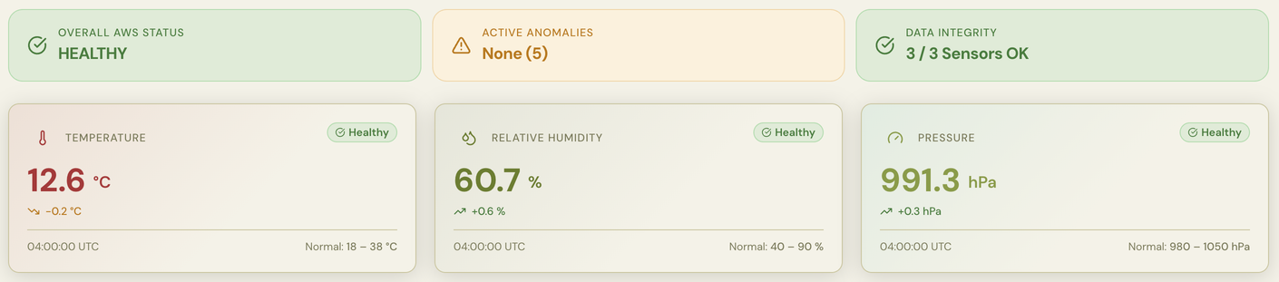
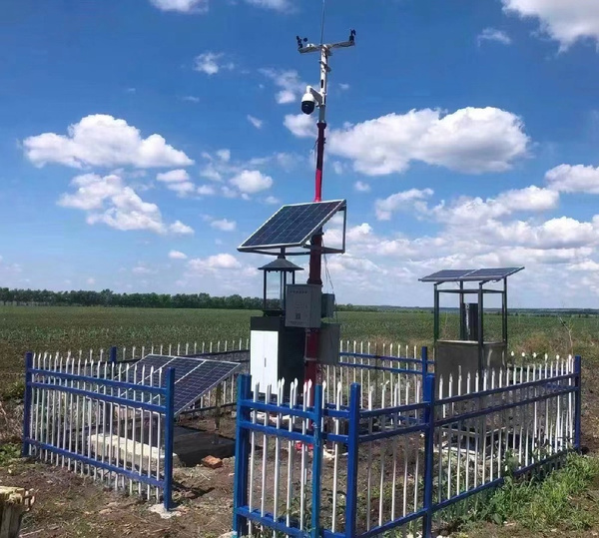


SkyGuard AI
AI/ML BASED ANOMALY DETECTOR FOR AWS
Sky Guard AI: An end to end pipeline that ingests AWS station’s data, cleans and engineers features, detects via Isolation Forest + Rule based checks and alerts on a live dashboard
Overall AWS Status
  Checks real time data and evaluates station’s health
Anomaly activity status
  Tells active anomalies
  States +ve/-ve spike in parameters as well
Sensor health monitoring
  Detects sensors deteriorating. Helps detect precise causes
2
Notes:
2

Slide 3

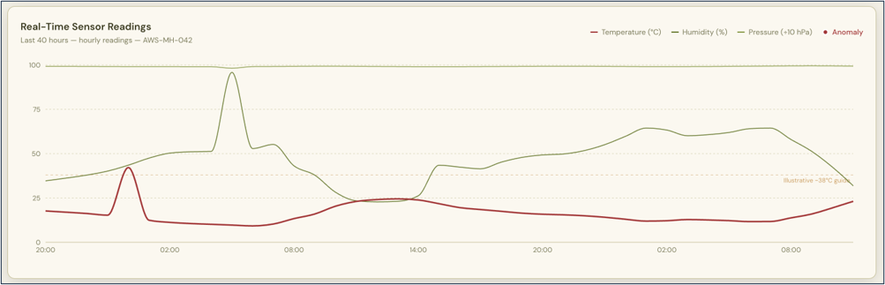
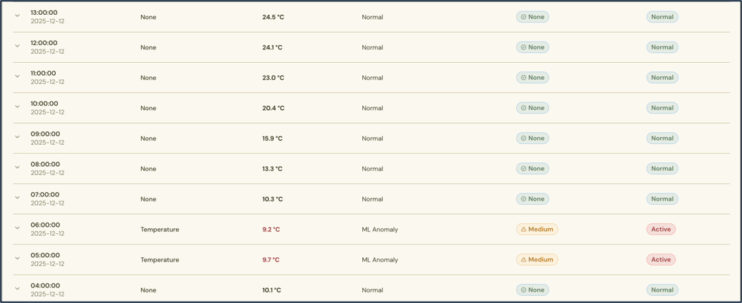
The solution
REAL-TIME MONITORING SENSORS
REAL-TIME TREND ANALYSIS
AI-POWERED ANOMALY DETECTION
Learns normal sensor behavior and automatically identifies abnormal patterns.
Continuously monitors temperature, humidity and pressure from AWS sensors
Visualizes sensor behavior to reveal sudden changes, drift and correlated anomalies.
See It In Action Here
EXPLAINABLE ANOMALY LOGS
+
ACTIONABLE EARLY WARNING
Every detected anomaly is recorded with its sensor, timestamp, severity and status & Converts raw sensor data into clear, timely alerts for faster intervention.
3
3
Notes:
3

Slide 4
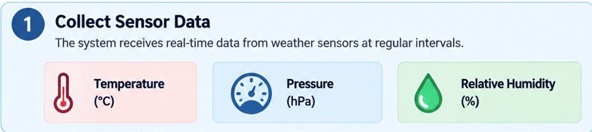

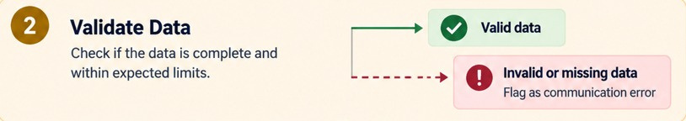

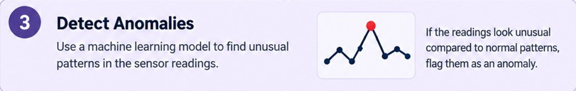
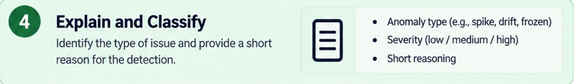


WORKFLOW & TECH-STACK
Python
Fast API
sklearn
pandas
NumPy
Next.js
React
Tailwind CSS
TypeScript
Streamlit
NASA
GitHub
4
Notes:
4

Slide 5

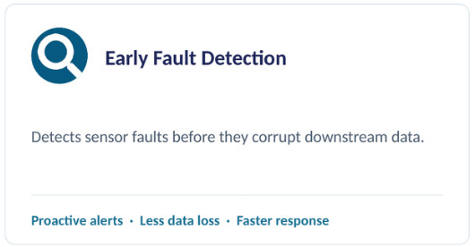



IMPACT & BENEFITS
5
Notes:
5

Slide 6
RESEARCH & REFERENCES
Links:
  NASA POWER : https://power.larc.nasa.gov/data-access-viewer/?utm_source=chatgpt.com
  Research related Links:
  A two-step machine learning approach for predictive maintenance and anomaly detection in environmental sensor systems: https://www.sciencedirect.com/science/article/pii/S2215016125000299?via%3Dihub
  Temperature, pressure, relative humidity and rainfall sensors early error detection system for automatic weather station (AWS) with artificial neural network (ANN) backpropagation: https://iopscience.iop.org/article/10.1088/1742-6596/1816/1/012056
  Team Members
  Shailesh 26BCSE105N004 [SEM-I]
  Himanshu 26BCSE103N011 [SEM-1]
  Dhruv Sharma 26BCSE105N016 [SEM-1]
  Lavanya 26BCSE102N002 [SEM-I]
  Manmeet Kaur 26BCSE105N010 [SEM-I]
  Saksham Mathur 26BCSE105N012 [SEM-I]
  Team Mentor
  Mr. Vijay Kumar [ Dept. Applied Sciences ]
6
Notes:
6

